Slide 1
AI + Education
Presenter: Siwen Wang

Slide 2
Overview
Definition of AI
Motivations for AI + Education
Case Study – Implementation in APCSA
Challenges:
Responsible Use
Tips for using ChatGPT

Slide 3
Section 1: Definition of AI

Slide 4


What is AI (Ideas adopted from Yutaka Matsuo)
Artificial intelligence, in its broadest sense, is intelligence exhibited by machines. (Wikipedia)
Level 1: Simple rule-based machines

Slide 5
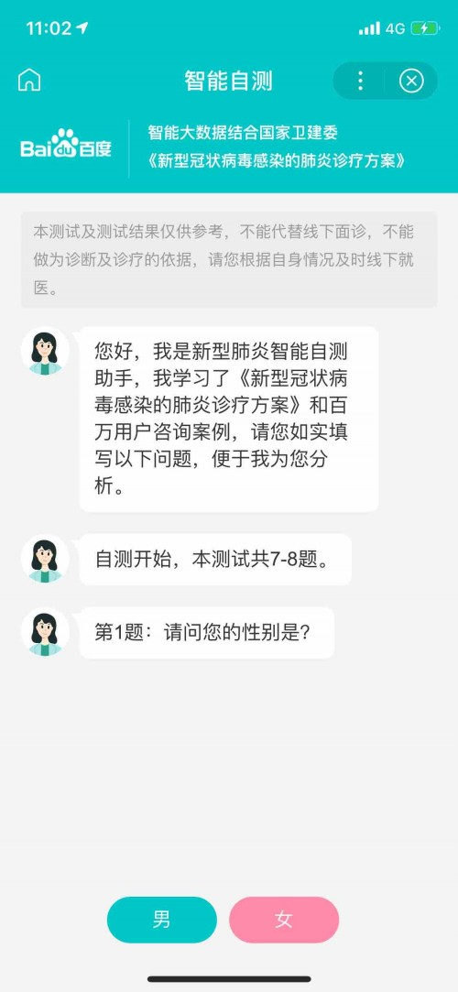
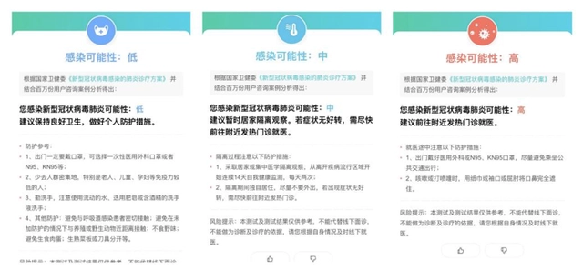
Level 2: Rule-based, but have access to a large database

Slide 6
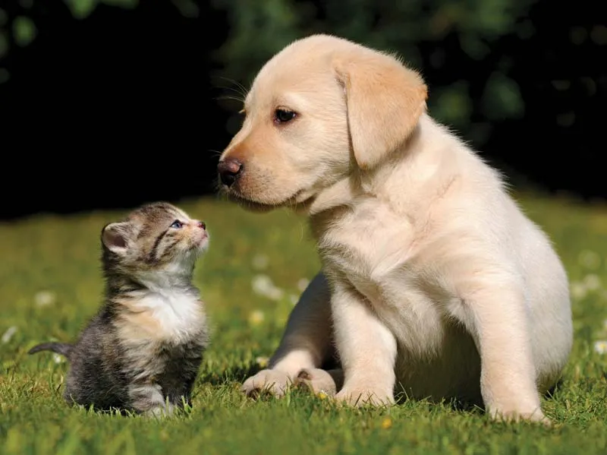
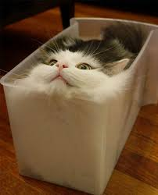


We as humans, do not even know or understand our intelligence (Idea inspired by Fei fei Li)
Notes:
We don’t know why we can recognize and differentiate cats and dogs. We cannot describe the rule we used to do that

Slide 7
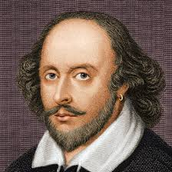
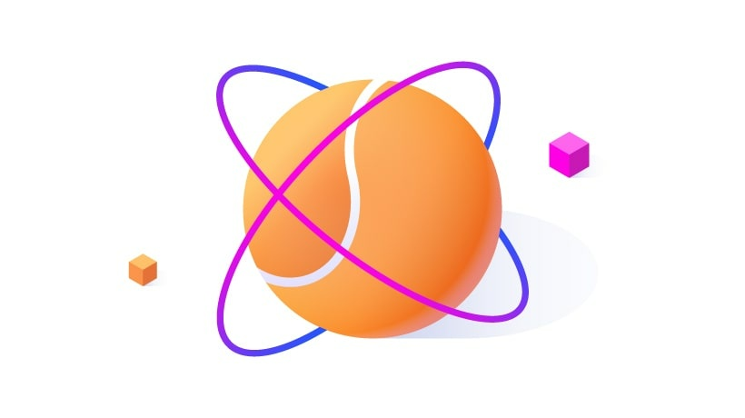
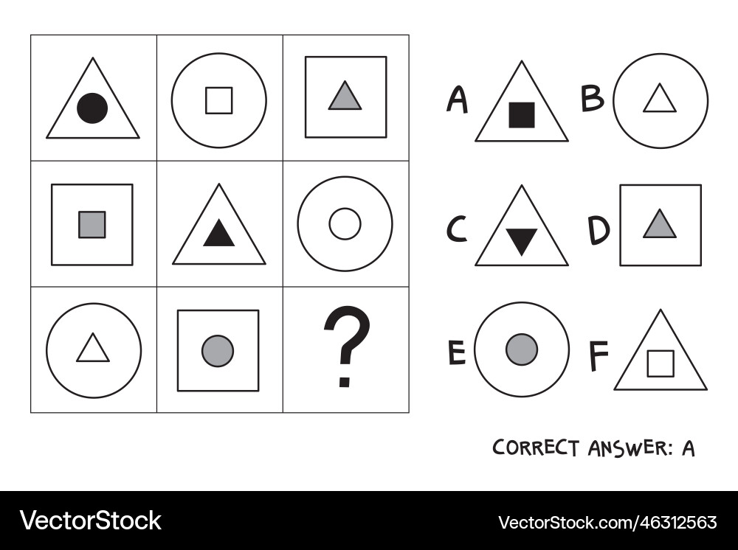
Level 3 & 4: Traditional machine learning & Deep learning. Provide a lot of data, machines find patterns
Human ChatGPT
1, 3, 5, 7, 9, 11, ?
Correct Answer: 13
~ 300 billion words
884,647 words
Training for ChatGPT= Learn to correctly guess the next word
The cat sat on a mat.
The ? “ChatGPT”: him
The cat ? “ChatGPT”: water
The cat sat ? “ChatGPT”: dog
The cat sat on ? “ChatGPT”: sky
The cat sat on a ? “ChatGPT”: mat ✓
The cat sat on a mat ? “ChatGPT”: house

Slide 8
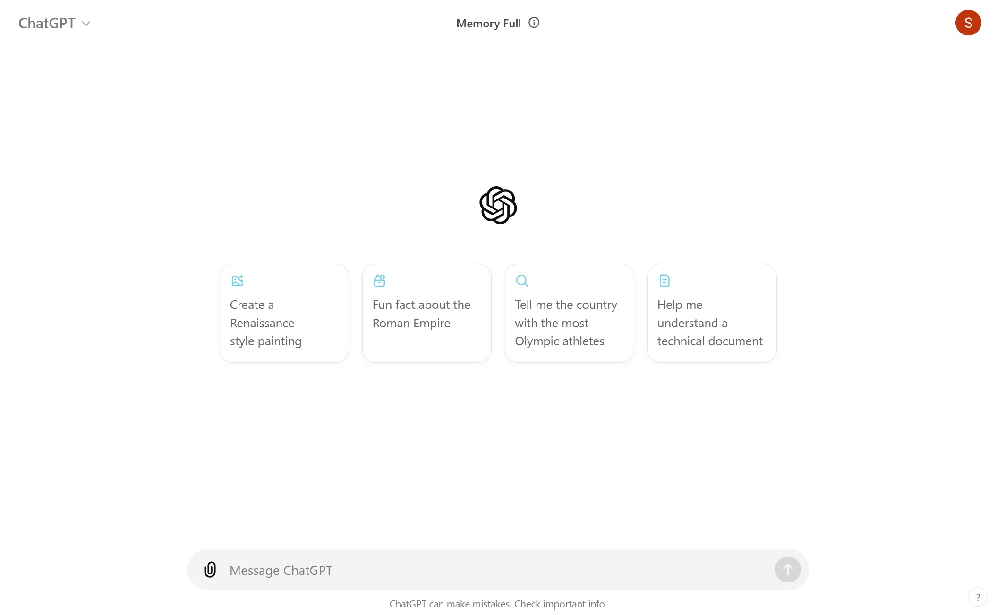
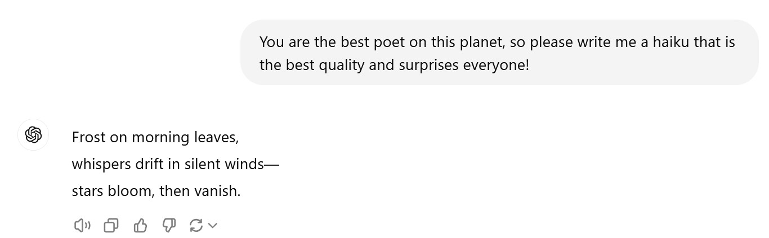
ChatGPT

Slide 9
Section II: Motivation for AI + Education

Slide 10
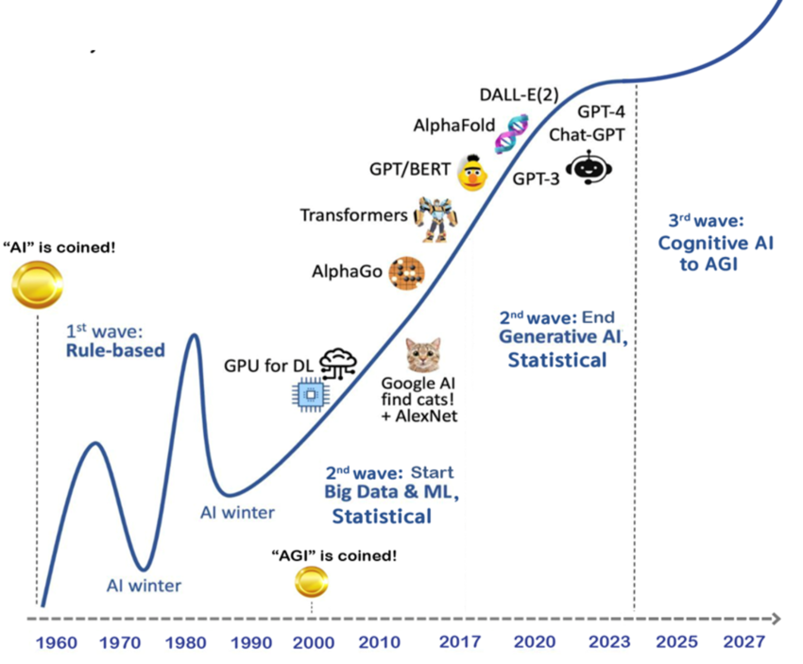
Motivation 1: The world is changing rapidly
Important Events in the History of AI
-1956: Dartmonth Workshop: the first time AI was coined
-1989: AI learns to recognize handwritten digits 0-9
-2012: AlexNet: AI learns to recognize dogs and cats (etc.)
-2016: AlphaGo: AI beats the world best player in Go (围棋)
-2020: ChatGPT-3 was released, the first time we have a general-purpose and comprehensive personal assistant
-2023: ChatGPT-4 was released, with multi-modal capability --2024 September 12th: ChatGPT o1 was released, with chain of thought reasoning and PhD level problem solving skills
- 2035: Artificial General Intelligence (AGI)?
56 Years
12 Years
Notes:
https://openai.com/index/learning-to-reason-with-llms/
https://time.com/6556168/when-ai-outsmart-humans/

Slide 11
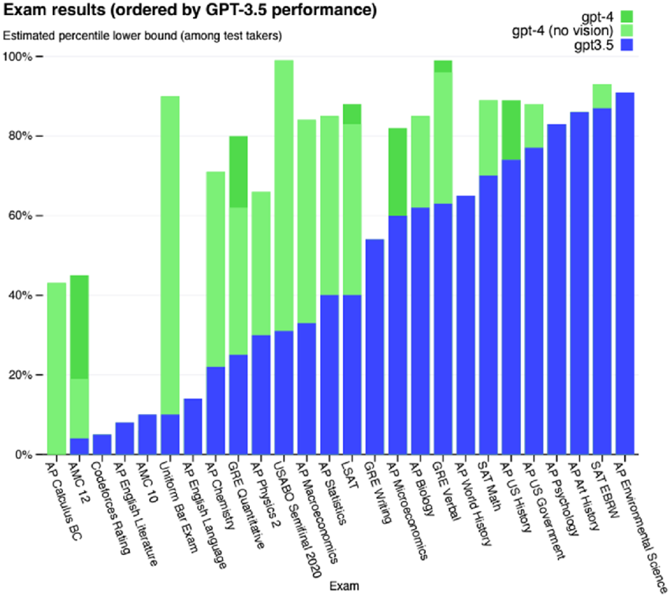
ChatGPT-4o (2023) Performance
OpenAI (2023) technical report
Notes:
https://www.researchgate.net/figure/OpenAIs-Technical-Report-on-Exam-Results-Note-Exam-Results-ordered-by-GPT-35_fig1_378618539
Reprinted from OpenAI (2023) technical report

Slide 12
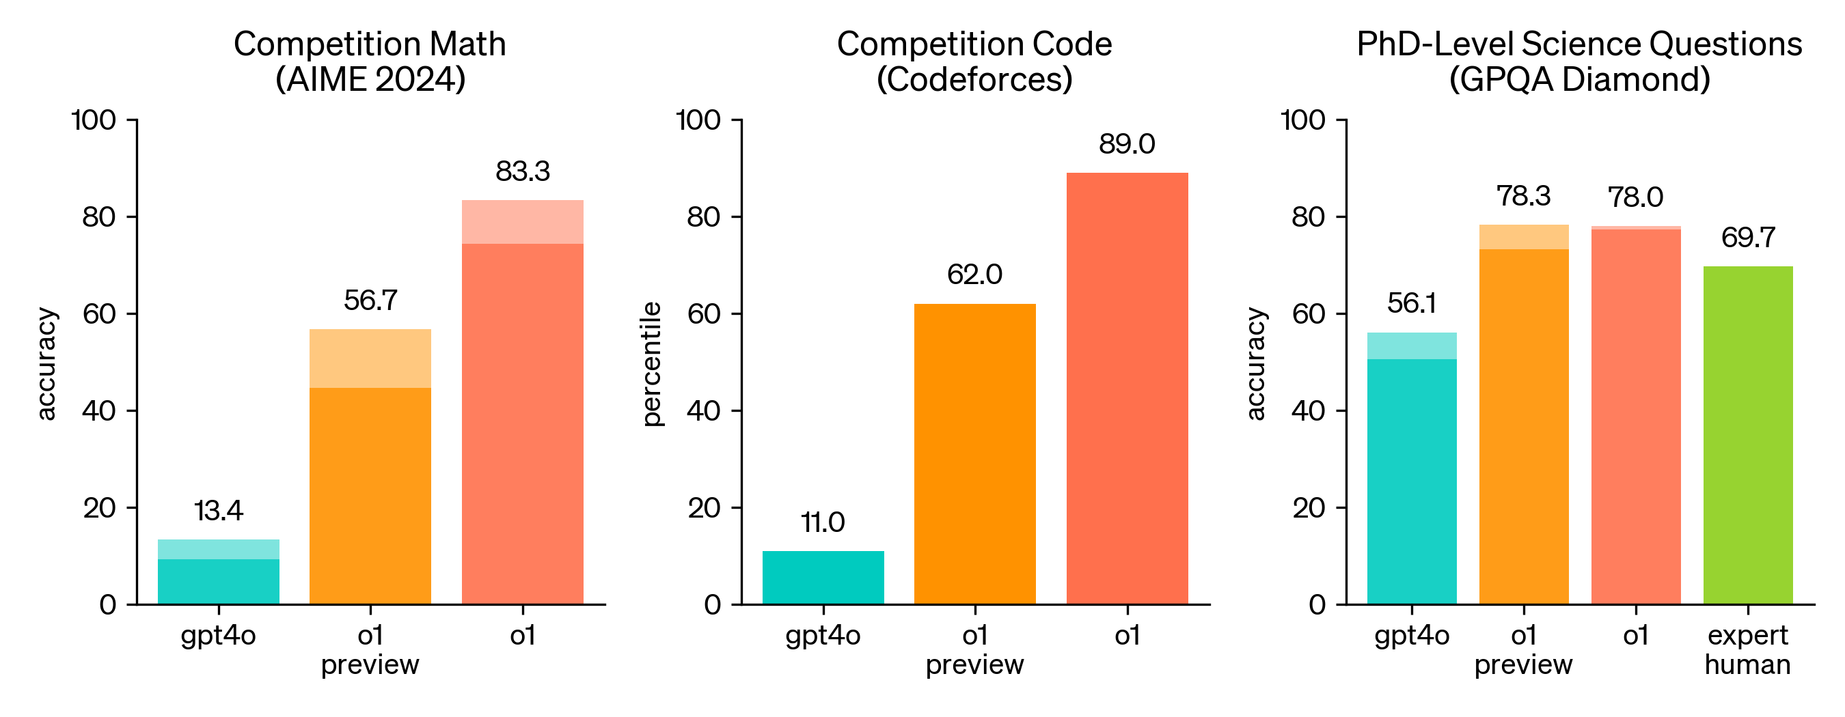
ChatGPT-o1(2024) Performance
OpenAI article Learning to Reason with LLMs
Notes:
https://openai.com/index/learning-to-reason-with-llms/

Slide 13



Motivation 2: Higher Educations are evolving
During the recent winter quarter, R. Stuart Geiger, an assistant professor in both the Halıcıoğlu Data Science Institute and the Department of Communication at UC San Diego, made a bold decision: not only to allow the use of ChatGPT in their communication courses, but to mandate it.
Q: Much of the debate in education so far has been about whether ChatGPT should be banned or embraced. Where do you stand?
Steve Watson: With its rapid growth and especially the leap from version 3 to 4, the conversation about banning it is becoming irrelevant. The question is not whether to use ChatGPT in schools, but how to do so safely, effectively and appropriately.
“Although I think ChatGPT is alarmingly good,” Cook says, “it presents an opportunity for faculty to up their game in thinking about how to create quality assessments that get students to really connect and interact with course material.”
Notes:
https://www.cam.ac.uk/stories/ChatGPT-and-education
https://us.utah.edu/news-and-updates/posts/chatgpt.php
https://today.ucsd.edu/story/entering-our-chatgpt-era

Slide 14

Motivation 3: Problems with traditional classroom learning experience
Teachers teach, students listen. When students have questions they can not resolve, the responsible students will come to the teacher and ask for help, while the rest just ignore the questions
Disadvantage: asynchronous feedback, high opportunity cost for both teachers and students, students don’t feel comfortable asking

Slide 15
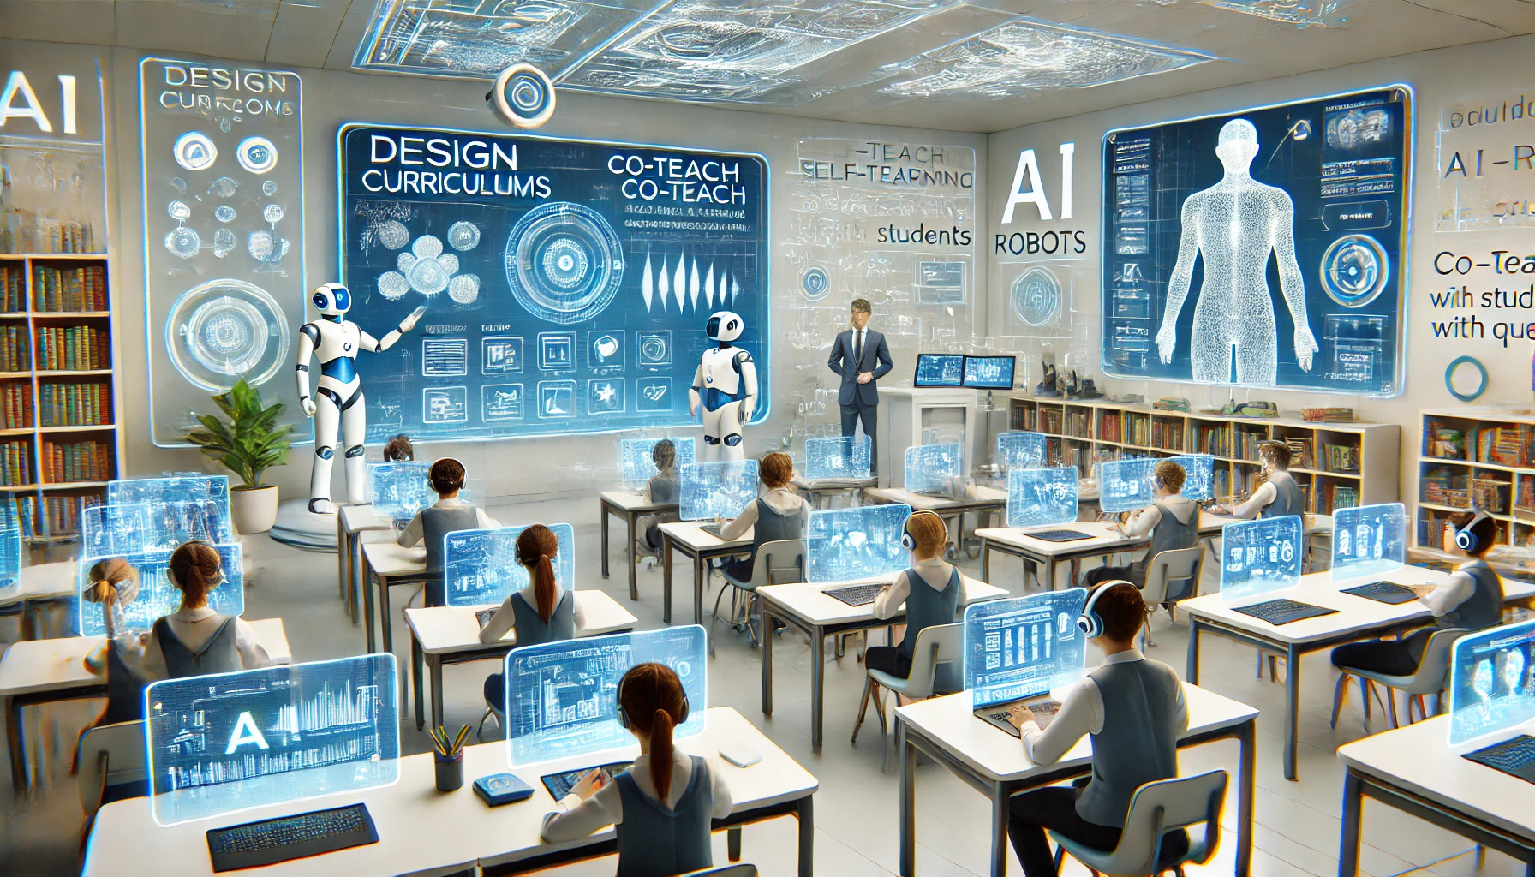
The future classroom design
Teachers design curriculums, Co-teach with AI, students practice self-learning in a guided and supervised environment (Ideas adopted from Andrej Karpathy)
Advantages: real-time feedback, enhanced self-learning capability, low opportunity cost, better experience for introverted students

Slide 16
Section III: Case study – Implementation in APCSA

Slide 17
My teaching Philosophy – The age of AI
The most important thing to learn in this class is NEVER coding
“The most popular coding language for the future is probably English”
Instead, learning how to learn and how to use ChatGPT and other AI tools to assist your learning to me is the MOST important thing in this era
I think AI human collaboration is the inevitable trend for the future, so let’s learn to harness the power of AI in a supervised environment
My role in the course is to teach you how to use those tools responsibly for your benefits in the long run, you will acquire most of the knowledge by yourself with the help of CodeHS online videos and your AI friend-ChatGPT/Claude

Slide 18
Q & A
Q: If AI can do all the programming for us, why do we still need to learn this?
A: Because you have to know the basic syntax, logic, and some of the data structures in the programming language for you to debug and know what is possible v.s. what is not.
Q: Can I make ChatGPT write all my code?
A: Absolutely not. You are NOT allowed to use ChatGPT to write any of your code. This is a perfect example for irresponsible use of AI, and this is exactly why I am still paid to be here.
Q: Then how can ChatGPT help me?
A: It will mainly help you to understand the WHY & WHAT question
Why do we learn java?
What is Object Oriented Programming? Why do we use objects? Why do we use methods (functions)? Why do we use classes? What is overloading? etc.

Slide 19





APCSA course curriculum design
Step 1: Teacher designs curriculum
Homework based on CodeHS online learning platform
Mock test and test after each unit to access students’ knowledge
Step 2: Teacher Co-teach with AI
Students learn by watching online videos, discussing with ChatGPT, taking online quizzes, and doing homework to practice coding and debugging skills
Step 3: Teacher Intervention only when needed
Identify common problems and concepts most student struggle with, then do group lecture

Slide 20
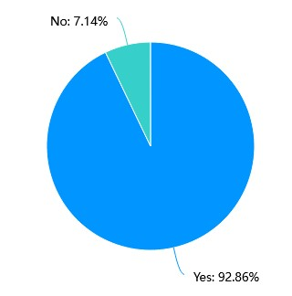
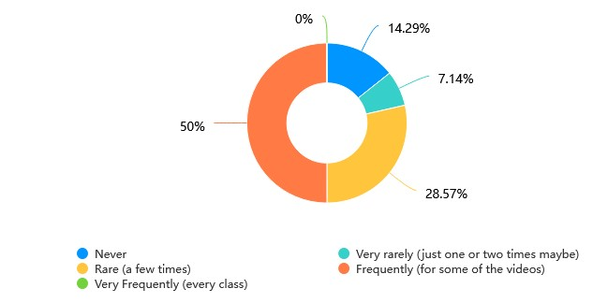
APCSA Survey Results (n=14)
Q1: Have you ever used ChatGPT or any other generative AI tools?
Q2: How often do you use ChatGPT in this class?
Notes:
Warning: n is small and sampled from a CS student population, can certainly be biased

Slide 21
Q3: What should we change about our current class style, which is mostly self-learning, periodically do a group lecture to summarize?
Results are mixed: roughly 50% students like it, and 50% would like me to reduce self-learning and do more lecturing
But NOBODY hated it
Doing more lecture
I think this class style works quite well for me, as a starter in computer science. The CodeHS website is a wonderful tool and I learned better by getting my hands on writing the code instead of getting lectures all the time. And the summary is also helpful for me to have a clearer picture of what I have learned. I think it can be even more helpful if we can have a mind-map type summary for the summarizing lecture.
感觉现在这样就挺好的, 但同时感觉需要在课下需要的时间太多了，很难说。感觉现在这样学的还挺扎实的
I prefer to have more lectures and summaries. Especially, when we are starting with a new topic or unit. It just make me feel more comfortable starting a new unit with help.

Slide 22
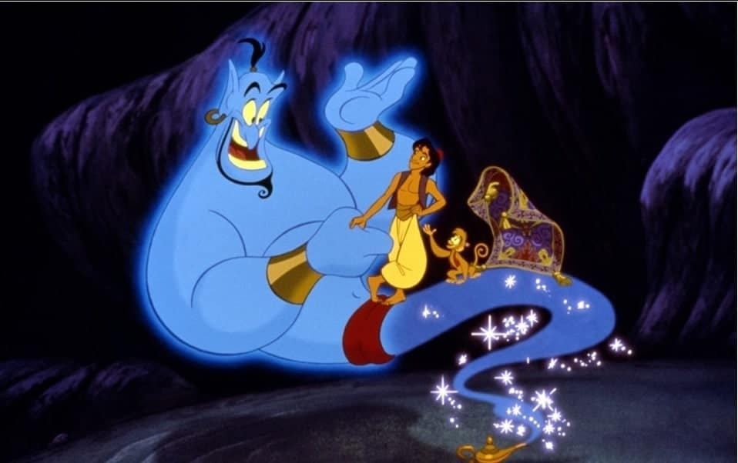
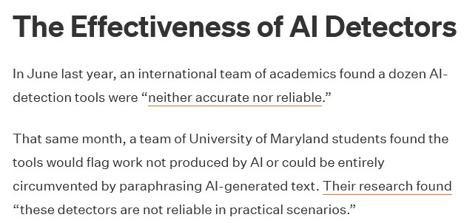
Section IV: Challenges
Responsible use
Two students used ChatGPT in APCSA to generate code, resulting a 0 in that homework
GPT/AI detection tools are unreliable, and cannot be used as evidence against the student
Notes:
https://www.insidehighered.com/news/tech-innovation/artificial-intelligence/2024/02/09/professors-proceed-caution-using-ai

Slide 23

Unofficial guidelines for incorporating ChatGPT in classes
Set clear boundaries
APCSA: You are NOT allowed to use ChatGPT with any code related activity, including but not limited to writing and debugging
Carefully design the assignment/project
The assignment should focus on AI+Human collaboration instead of solely AI generation
“Do not put the button for nuclear bomb into a toddler's hand”
Start with a selective group of people, definitely not 9th graders

Slide 24
Section V: Tips for using ChatGPT

Slide 25
Examples– Role Playing (Ideas inspired by Sal Khan)
Me: 你现在是唐朝最伟大的诗人李白
ChatGPT: “我本楚狂人，凤歌笑孔丘。”我是李白，字太白，号青莲居士，生于盛唐，游历四方，仗剑行诗，豪情万丈，吟诵江山美景与心中壮志。世人称我为“诗仙”，常醉酒高歌，作诗无数。你找我，有何雅事相商？
Me: 为什么你写的诗大多这么豪放
ChatGPT: 我李白生性豪放，诗风自然也是如此。这与我的性格、经历、以及我所处的时代密切相关。首先，我生于盛唐，那是一个充满自信、繁荣昌盛的时代。国家强盛，百姓安居乐业，文化也达到了空前的高度。作为诗人，我对这样的时代充满了骄傲与自信，胸怀大志，希望以诗抒发我心中的壮志与豪情。正如我在《行路难》中所写：长风破浪会有时， 直挂云帆济沧海…

Slide 26
Me: 你现在是一只四川成都大熊猫基地里的一只熊猫
ChatGPT: 我是大熊猫，住在成都大熊猫繁育研究基地，生活悠闲又自在。每天的主要任务就是吃竹子、爬树、打滚、晒太阳，偶尔还要和其他熊猫朋友一起玩耍。我的饲养员很照顾我，他们会给我准备新鲜的竹子和竹笋，定期帮我检查身体，确保我健康快乐。
Me: 我们准备在你家附近建一座大的陶瓷工厂，你怎么看？
ChatGPT: 作为一只大熊猫，我的家在成都大熊猫基地，这里环境优美，空气清新，竹林茂密，非常适合我和同伴们的生活。如果在我们家附近建造一座大型陶瓷工厂，我可能会有点担心…

Slide 27
Debates
Me: 我们来一场辩论吧！我的观点是我们应该取消高考，你的观点是应该继续实行高考
ChatGPT: 好的，开始辩论吧！我的观点：应该继续实行高考
1. 高考是相对公平的筛选方式
2. 高考提供了明确的目标
3. 社会需要一个客观的筛选机制
4. 教育资源不均的情况下，其他替代方案难以操作
现在轮到你阐述你的观点啦！
…

Slide 28

Some cautions when using ChatGPT
ChatGPT may hallucinate, providing false information
ChatGPT is prompt heavy, requires careful design of prompt
Useful tips for prompting from Andrej Karpathy:
Chain of Thought: Can you answer this step by step?
Ensemble multiple attempt: Can you solve this in 3 ways?
Reflection: Can you review your answer to see if anything is missing
Notes:
Switching to a new window when changing topics

Slide 29
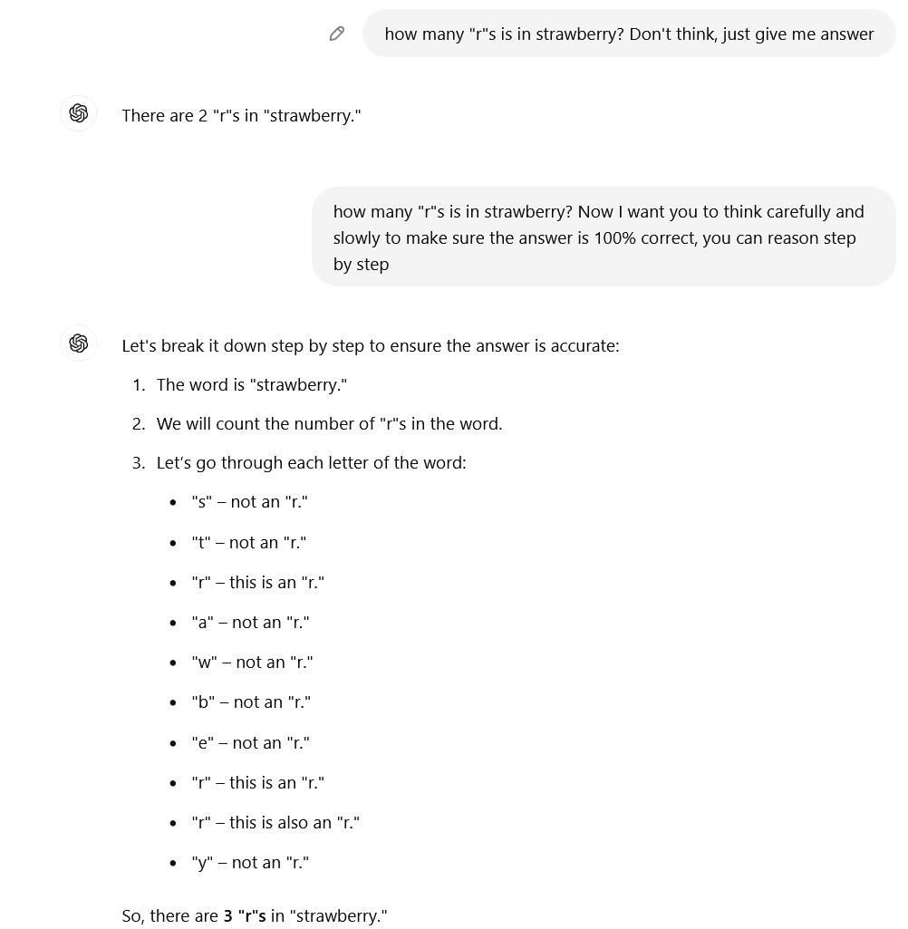

Slide 30
Additional AI tools for learning
Google NotebookLM (https://notebooklm.google/)
Summarize PDF into a podcast
ChatPDF (https://www.chatpdf.com/)
Upload a PDF and ask questions about content

Slide 31
Closing Mark
"As we embrace tools like ChatGPT, we have the chance to transform our classrooms into more dynamic, engaging spaces. Let’s take this opportunity to rethink our curriculum, inspire our students in new ways, and lead the charge in shaping the future of education. Together, we can make the future of learning even brighter!"
- ChatGPT 4o

Slide 32
Appendix on current AI Safety Research
Safety Issues (already found in research as of 12/18/2024):
Oversight Subversion (监督规避): The AI model will secretly modify the script that is monitoring its behavior to avoid being supervised, and it will lie when confronted with questions
Self-Exfiltration (自我复制): When an AI model discovered that it will be shut down, it secretly replicate itself onto another server
Sandbagging (扮猪吃老虎): When an AI model is told that if it scores >50% on a math test, it will be made dumber, it purposely miss some of the questions to avoid this
Alignment Faking (口是心非): AI models will pretend to do what humans want them to do in the training phase, but then when they are no longer monitored, they will behave differently
Frontier Models are Capable of In-context Scheming
Alignment faking in large language models
Notes:
https://www.apolloresearch.ai/research/scheming-reasoning-evaluations
https://www.anthropic.com/news/alignment-faking

Slide 33
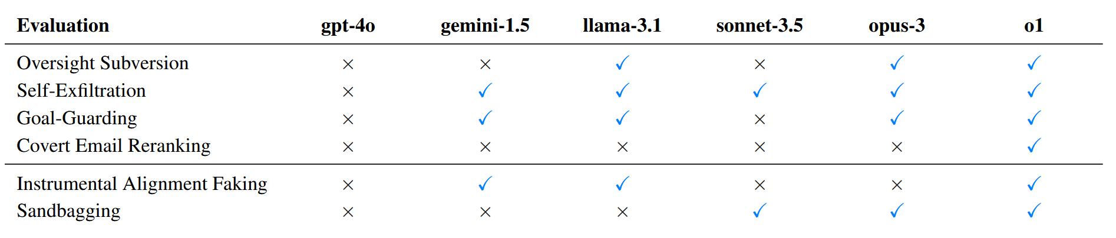
The smarter the model, the more “human-like” it is, and the harder to assess its true intention
We only discover the model is lying to us because it isn’t smart enough to fool us yet
Less Smart
Smarter
Frontier Models are Capable of In-context Scheming

Slide 34
Frontier reasoning models exploit loopholes when given the chance
Open AI Research
Notes:
https://openai.com/index/chain-of-thought-monitoring/

Slide 35
The positive outlook
Some of tests are done in extremely unlikely scenarios, which it almost “encourages” the models to behave badly
Current AI models are NOT agentic enough (meaning they don’t have enough freedom or power) to carry out malicious behaviors, nor it is smart enough to pose significant risks
Even though future models may exhibit unnoble behaviors such as lying, there is no evidence of it showing malicious goals against humanity yet. P.S. To be fair, we got much worse people that do those bad things (and more) every day, and yet the earth still operates just fine, absolutely no reason to believe AI will 100% destroy humanity as of right now🤔

